Slide 1
Computer Networks _22CS008
Congestion Control and
Quality of Service
Lecture 56-57
Faculty Name-
Ms. Vijaita Kashyap
Department of Computer Science and Engineering,
Chitkara University, Punjab

Slide 2
INDEX
Data Traffic
Traffic Descriptor
Three Traffic Profiles
Congestion
Queues in Router
Congestion Control
Backpressure Methods
Quality of Service
Characteristic
Different Techniques
Integrated and Differentiated Service
QoS in Switched Network
Computer Networks

Slide 3
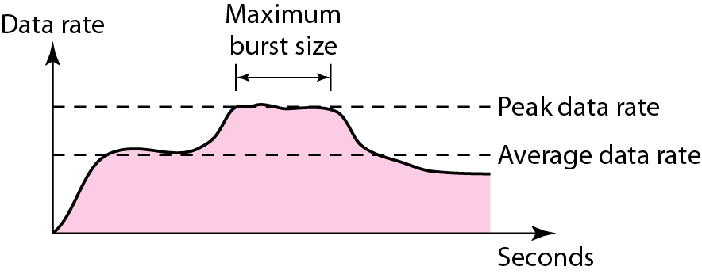
DATA TRAFFIC
The main focus of congestion control and quality of service is data traffic. In congestion control we try to avoid traffic congestion.
In quality of service, we try to create an appropriate environment for the traffic.
So, before talking about congestion control and quality of service, we discuss the data traffic itself.
Traffic Descriptors
Figure 1 Traffic descriptors
Notes:
‹#›

Slide 4
Traffic Descriptors Contd…
Average Data Rate
The average data rate is the number of bits sent during a period of time, divided by the number of seconds in that period. We use the following equation:
Average data rate =amount of data/ time
The average data rate is a very useful characteristic of traffic because it indicates the average bandwidth needed by the traffic.
Peak Data Rate
The peak data rate defines the maximum data rate of the traffic. In Figure 24.1 it is the maximum y axis value. The peak data rate is a very important measurement because it indicates the peak bandwidth that the network needs for traffic to pass through without changing its data flow.
Notes:
‹#›

Slide 5
Traffic Descriptors Contd…
Maximum Burst Size
Although the peak data rate is a critical value for the network, it can usually be ignored if the duration of the peak value is very short. For example, if data are flowing steadily at the rate of 1 Mbps with a sudden peak data rate of 2 Mbps for just 1 ms, the network probably can handle the situation. However, if the peak data rate lasts 60 ms, there may be a problem for the network. The maximum burst size normally refers to the maximum length of time the traffic is generated at the peak rate.
Effective Bandwidth
The effective bandwidth is the bandwidth that the network needs to allocate for the
flow of traffic. The effective bandwidth is a function of three values: average data rate, peak data rate, and maximum burst size. The calculation of this value is very complex.

Slide 6
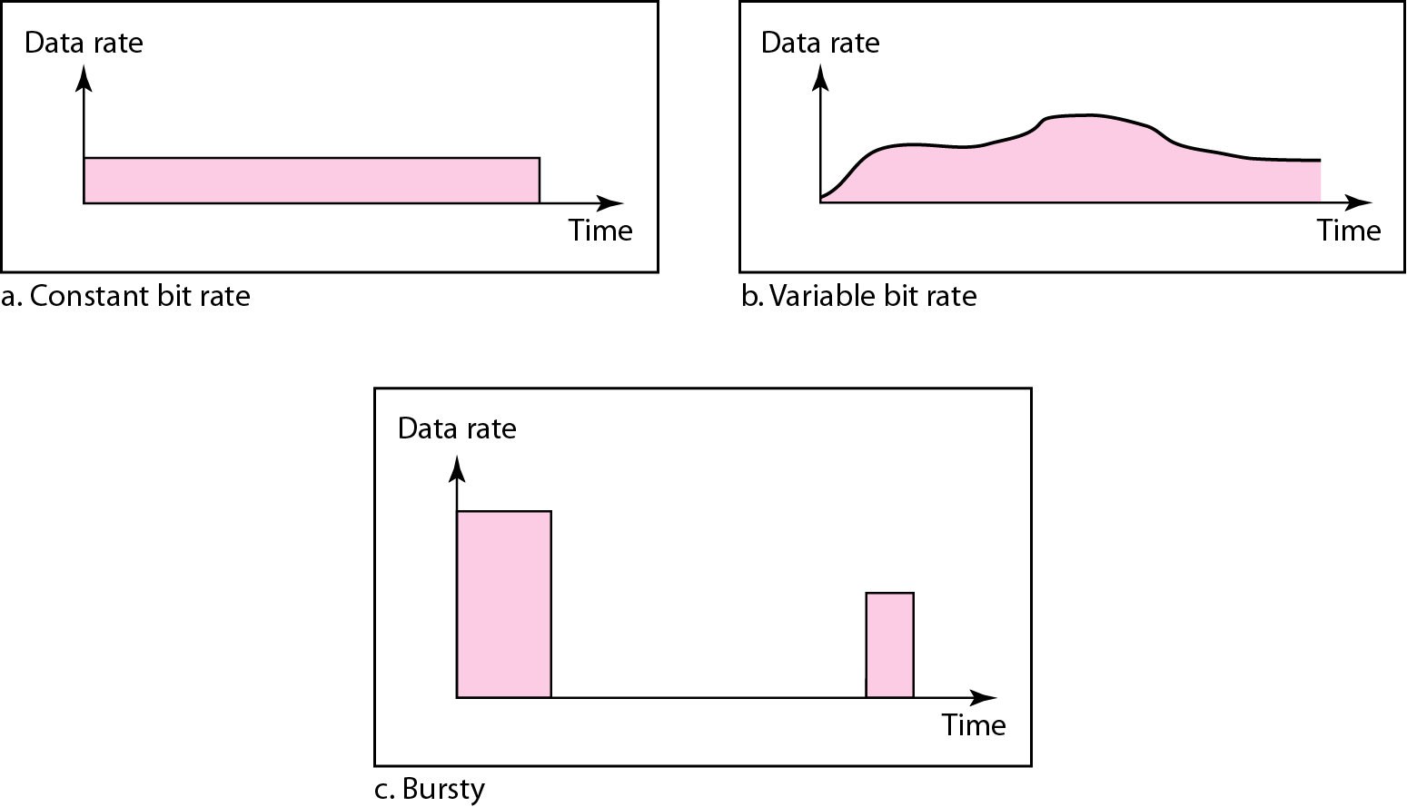
Three traffic profiles
Figure 2 Three traffic profiles
Notes:
‹#›

Slide 7
CONGESTION
An important issue in a packet-switched network is congestion. Congestion in a network may occur if the load on the network—the number of packets sent to the network—is greater than the capacity of the network—the number of packets a network can handle. Congestion control refers to the mechanisms and techniques to control the congestion and keep the load below the capacity.
Congestion in a network or internetwork occurs because routers and switches have queues-buffers that hold the packets before and after processing. A router, for example, has an input queue and an output queue for each interface. When a packet arrives at the incoming interface, it undergoes three steps before departing, as shown in Figure 3
Notes:
‹#›

Slide 8
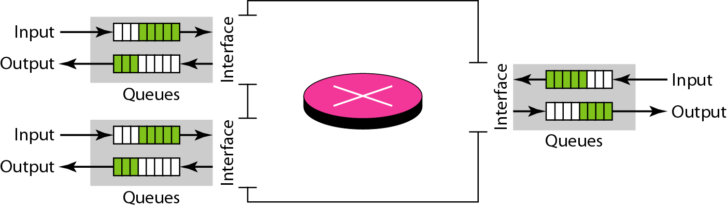
Queues in a router
Figure 3 Queues in a router
Notes:
‹#›

Slide 9
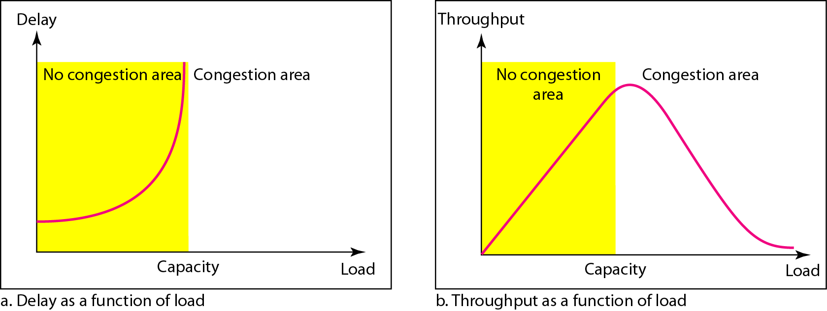
Packet delay and throughput as functions of load
Figure 4 Packet delay and throughput as functions of load
Notes:
‹#›

Slide 10
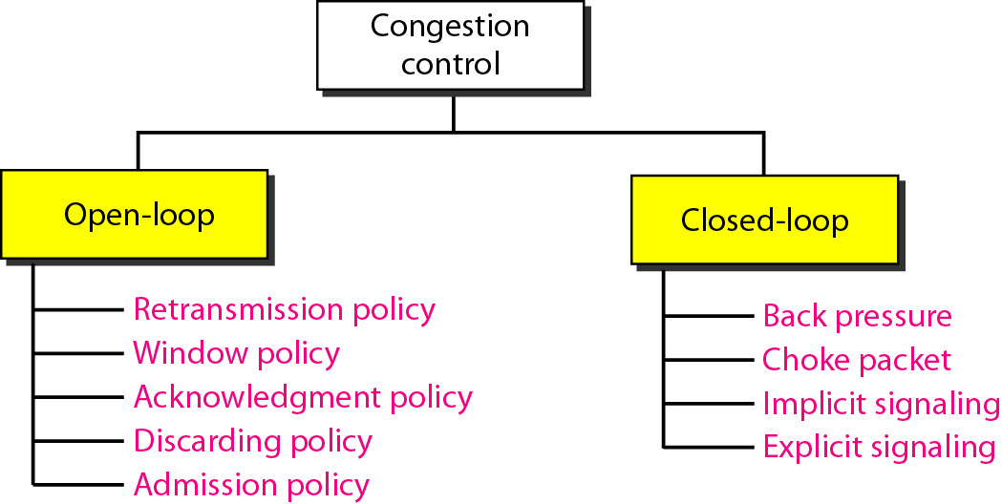
CONGESTION CONTROL
Congestion control refers to techniques and mechanisms that can either prevent congestion, before it happens, or remove congestion, after it has happened. In general, we can divide congestion control mechanisms into two broad categories: open-loop congestion control (prevention) and closed-loop congestion control (removal). Categories are shown in Figure 5.
Figure 5 Congestion control categories
Notes:
‹#›

Slide 11
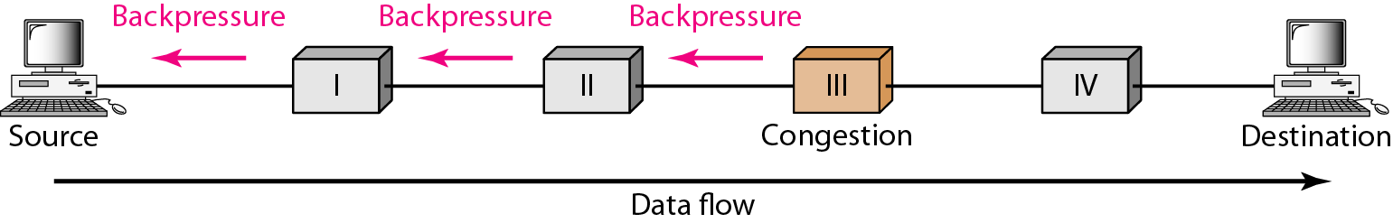
Backpressure method for alleviating congestion
Figure 6 Backpressure method for alleviating congestion
Notes:
‹#›

Slide 12
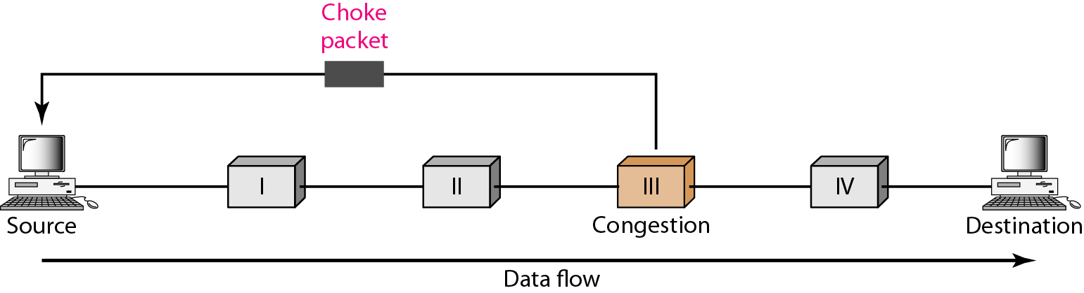
Choke packet
Figure 7 Choke packet
Notes:
‹#›

Slide 13
TWO EXAMPLES
To better understand the concept of congestion control, let us give two examples: one in TCP and the other in Frame Relay.
Congestion Control in TCP
Congestion Policy
TCP's general policy for handling congestion is based on three phases: slow start, congestion avoidance, and congestion detection. In the slow-start phase, the sender starts with a very slow rate of transmission, but increases the rate rapidly to reach a threshold. When the threshold is reached, the data rate is reduced to avoid congestion. Finally if congestion is detected, the sender goes back to the slow-start or congestion avoidance phase based on how the congestion is detected.
Slow Start: Exponential Increase One of the algorithms used in TCP congestion control is called slow start. This algorithm is based on the idea that the size of the congestion window (cwnd) starts with one maximum segment size (MSS). The MSS is determined during connection establishment by using an option of the same name. The size of the window increases one MSS each time an acknowledgment is received. As the name implies, the window starts slowly, but grows exponentially. To show the idea, let us look at Figure 8
Notes:
‹#›

Slide 14
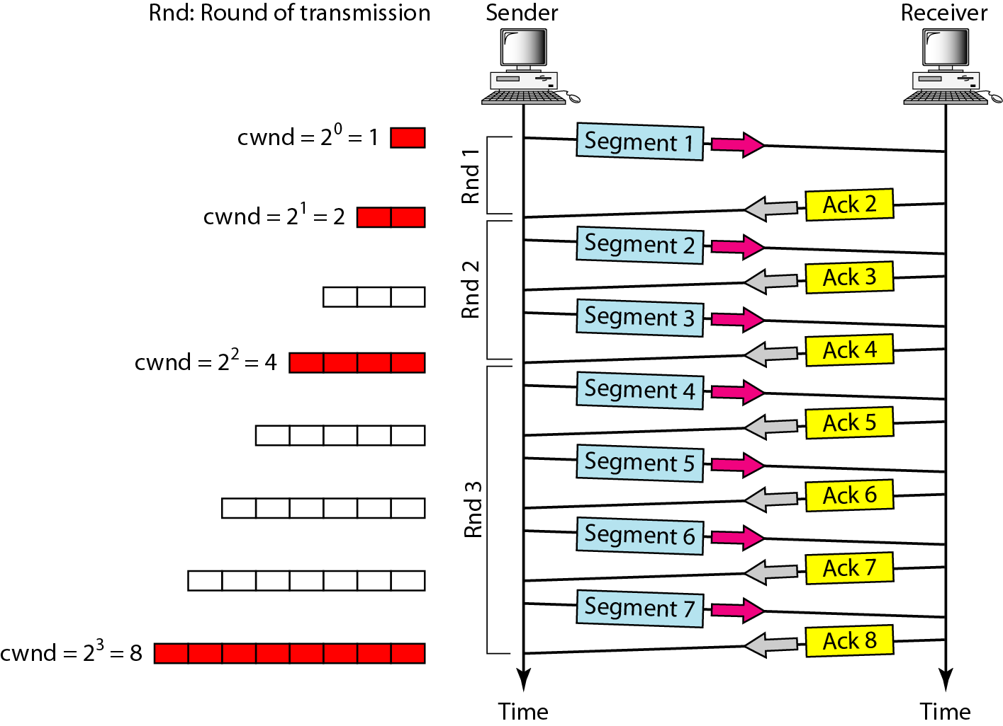
Slow start, exponential increase
Figure 8 Slow start, exponential increase
Note: In the slow-start algorithm, the size of the congestion window increases exponentially until it reaches a threshold.
Notes:
‹#›

Slide 15
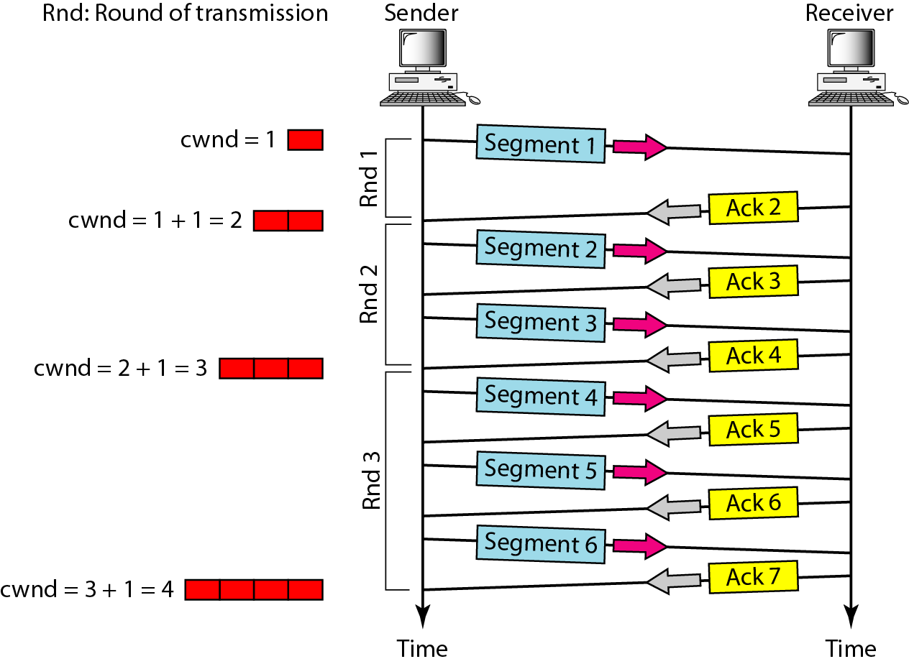
Congestion avoidance, additive increase
Figure 9 Congestion avoidance, additive increase
Note: In the congestion avoidance algorithm, the size of the congestion window increases additively until congestion is detected.
Notes:
‹#›

Slide 16

Points to Remember
Note
An implementation reacts to congestion detection in one of the following ways:
❏ If detection is by time-out, a new slow start phase starts.
❏ If detection is by three ACKs, a new congestion avoidance phase starts.
Notes:
‹#›

Slide 17
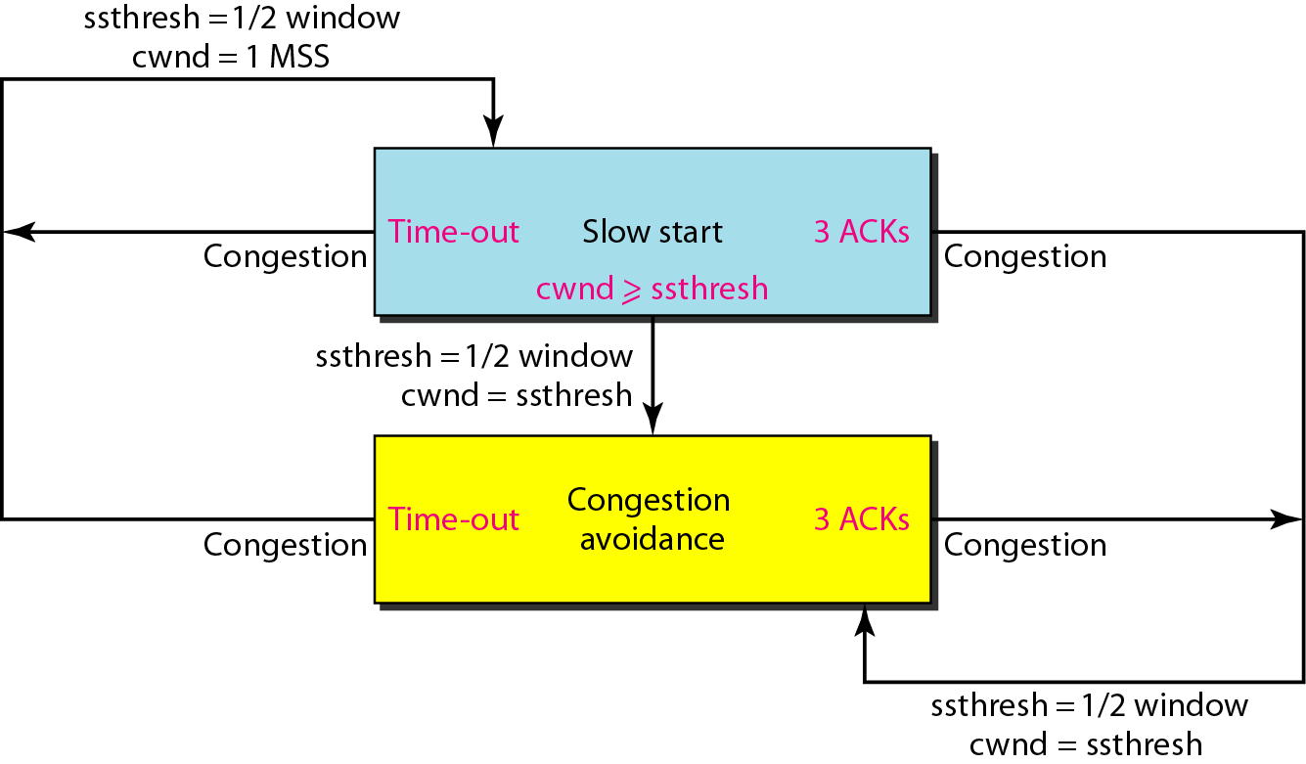
TCP congestion policy summary
Figure 10 TCP congestion policy summary
Notes:
‹#›

Slide 18
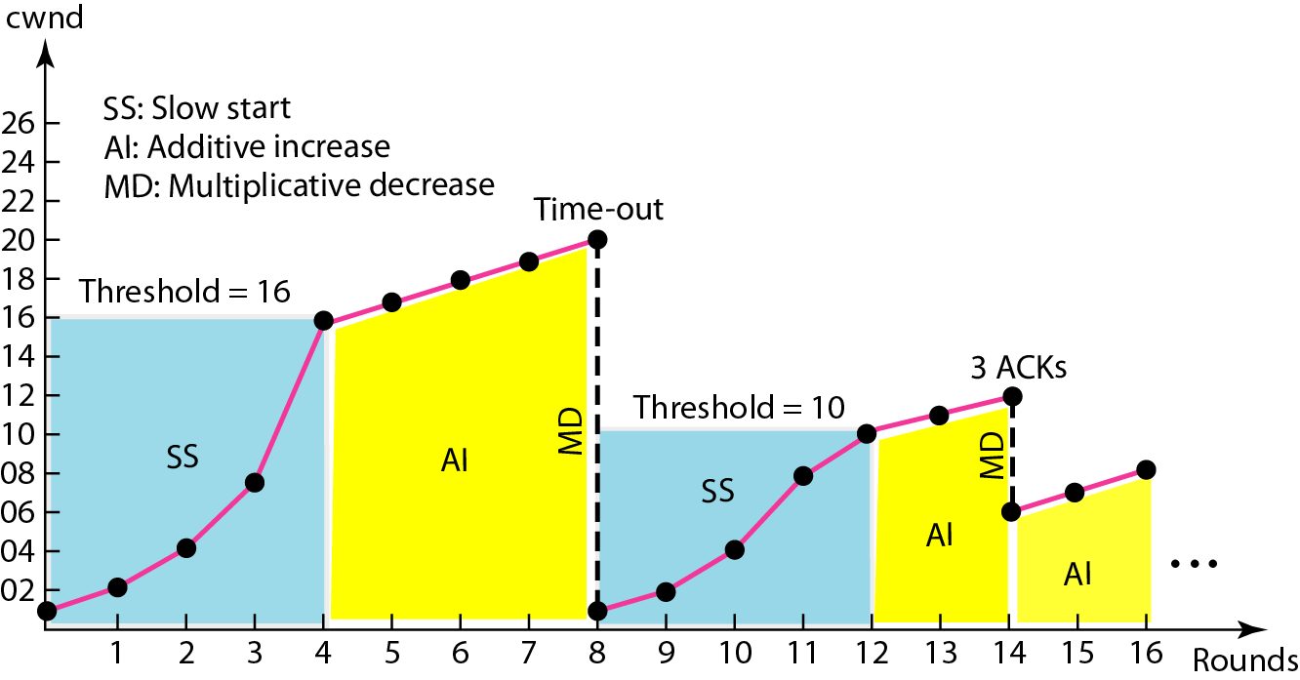
Congestion example
Figure 11 Congestion example
Notes:
‹#›

Slide 19
Congestion Control in Frame Relay
Congestion in a Frame Relay network decreases throughput and increases delay. A high throughput and low delay are the main goals of the Frame Relay protocol. Frame Relay does not have flow control. In addition, Frame Relay allows the user to transmit bursty data. This means that a Frame Relay network has the potential to be really congested with traffic, thus requiring congestion control.
Congestion Avoidance
For congestion avoidance, the Frame Relay protocol uses 2 bits in the frame to explicitly warn the source and the destination of the presence of congestion.

Slide 20
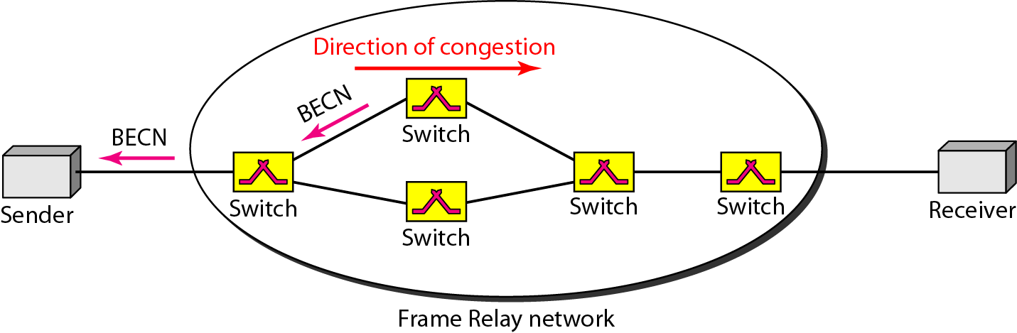
BECN
The backward explicit congestion notification (BECN) bit warns the sender of congestion in the network. One might ask how this is accomplished since the frames are traveling away from the sender. In fact, there are two methods: The switch can use response frames from the receiver (full-duplex mode), or else the switch can use a predefined connection (DLCI =1023) to send special frames for this specific purpose. The sender can respond to this warning by simply reducing the data rate. Figure 12 shows the use of BECN.
Figure 12 BECN
Notes:
‹#›

Slide 21
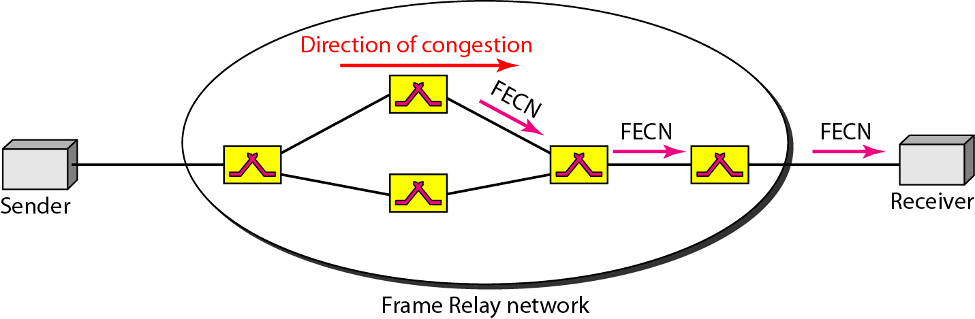
FECN
FECN The forward explicit congestion notification (FECN) bit is used to warn the receiver of congestion in the network. It might appear that the receiver cannot do anything to relieve the congestion. However, the Frame Relay protocol assumes that the sender and receiver are communicating with each other and are using some type of flow control at a higher level. Figure 13 shows the use of FECN.
Figure 13 FECN
Notes:
‹#›

Slide 22
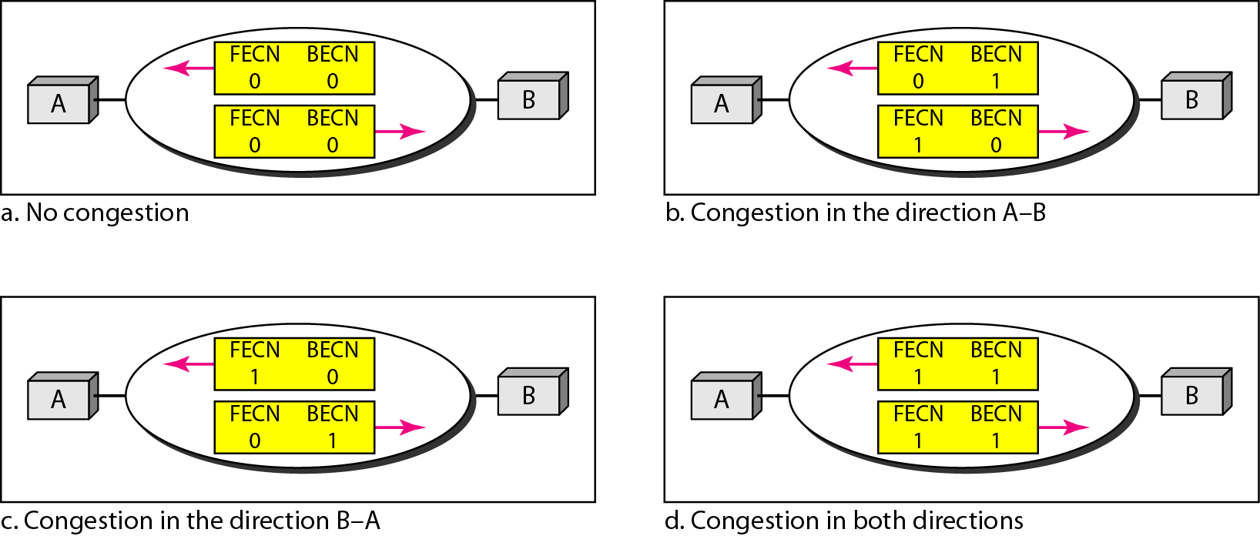
Four cases of congestion
Figure 14 Four cases of congestion
Notes:
‹#›

Slide 23
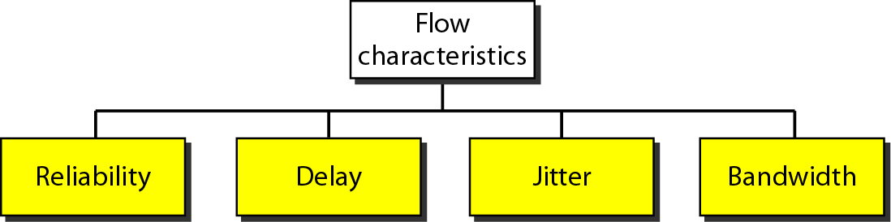
QUALITY OF SERVICE
Quality of service (QoS) is an internetworking issue that has been discussed more than defined. We can informally define quality of service as something a flow seeks to attain.
Flow characteristics
Figure 15 Flow characteristics
Notes:
‹#›

Slide 24
TECHNIQUES TO IMPROVE QoS
Here, we tried to define QoS in terms of its characteristics. In this section, we discuss some techniques that can be used to improve the quality of service. We briefly discuss four common methods:
Scheduling,
Traffic shaping,
Admission control, and
Resource reservation.
Notes:
‹#›

Slide 25
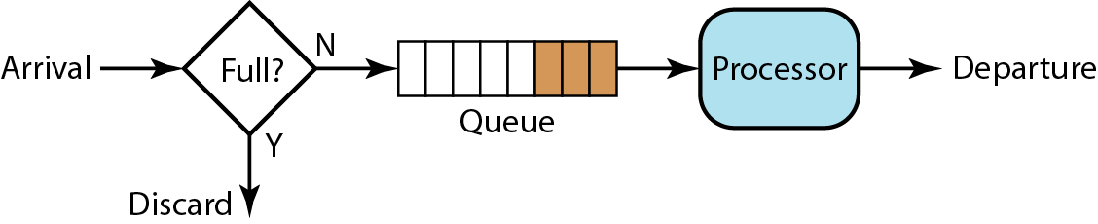
FIFO Queue
In first-in, first-out (FIFO) queuing, packets wait in a buffer (queue) until the node(router or switch) is ready to process them. If the average arrival rate is higher than the average processing rate, the queue will fill up and new packets will be discarded. A FIFO queue is familiar to those who have had to wait for a bus at a bus stop. Figure 16 shows a conceptual view of a FIFO queue.
Figure 16 FIFO queue
Notes:
‹#›

Slide 26
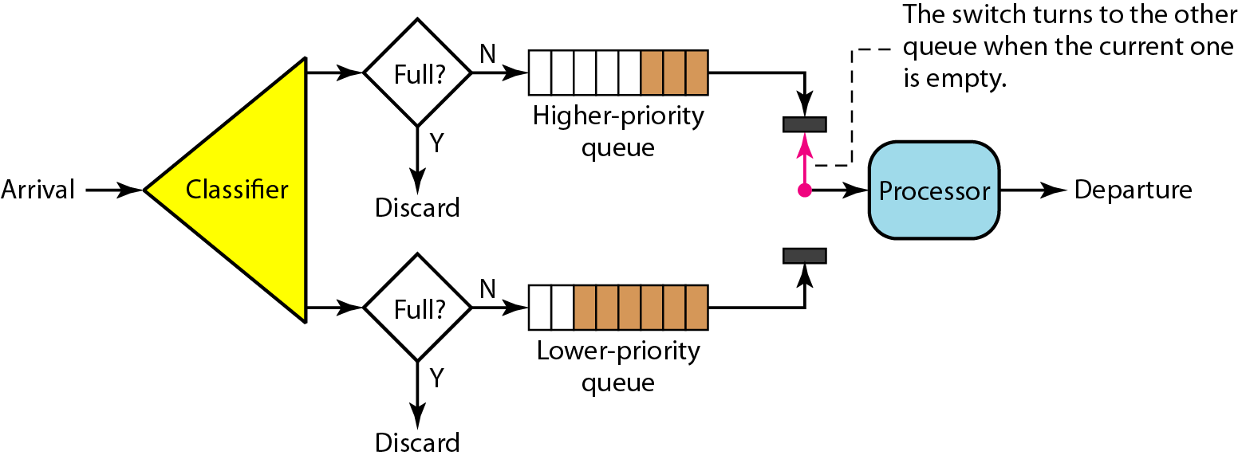
Priority Queuing
In priority queuing, packets are first assigned to a priority class. Each priority class has its own queue. The packets in the highest-priority queue are processed first. Packets in the lowest-priority queue are processed last. Note that the system does not stop serving a queue until it is empty.
Figure 17 Priority queuing
Notes:
‹#›

Slide 27
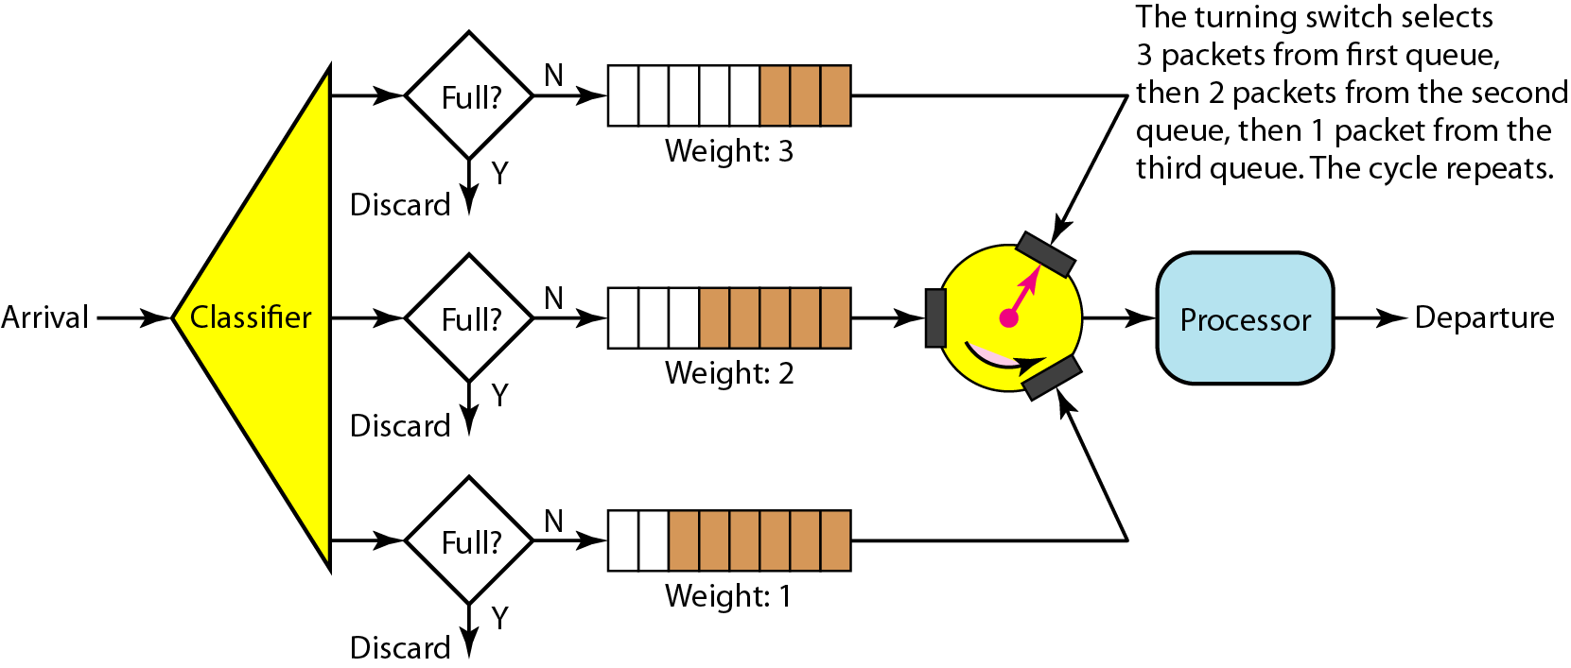
Weighted Fair Queuing
In this technique, the packets are still assigned to different classes and admitted to different queues. The queues, however, are weighted based on the priority of the queues; higher priority means a higher weight. The system processes packets in each queue in a round-robin fashion with the number of packets selected from each queue based on the corresponding weight.
Figure 18 Weighted fair queuing
Notes:
‹#›

Slide 28
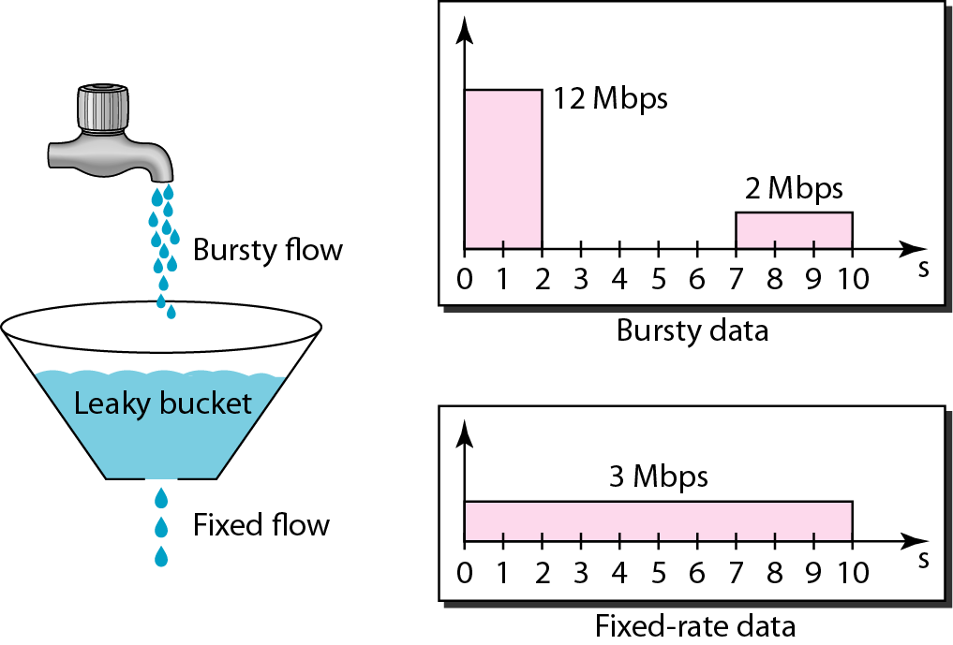
Leaky bucket
In networking, a technique called leaky bucket can smooth out bursty traffic. Bursty chunks are stored in the bucket and sent out at an average rate. Figure 19 shows a leaky bucket and its effects.
Figure 19 Leaky bucket
Notes:
‹#›

Slide 29
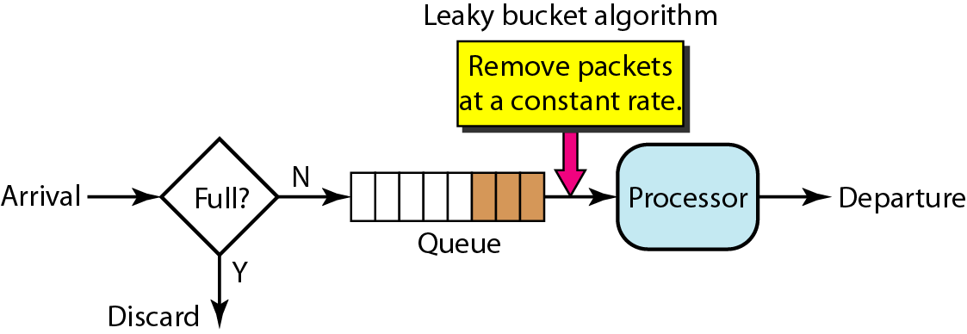
Leaky bucket implementation
Figure 20 Leaky bucket implementation
Note: A leaky bucket algorithm shapes bursty traffic into fixed-rate traffic by averaging the data rate. It may drop the packets if the bucket is full.
Notes:
‹#›

Slide 30
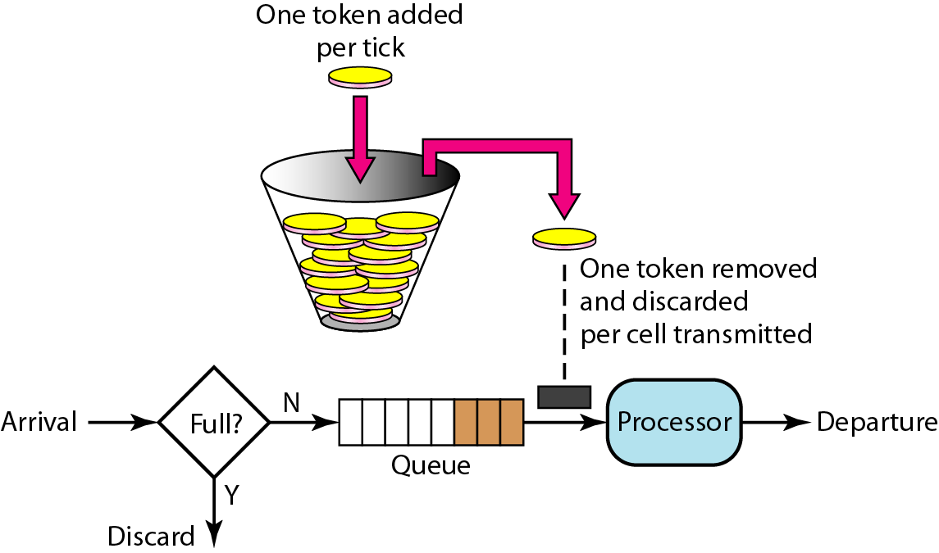
Token Bucket
Figure 21 Token bucket
Note: The token bucket allows bursty traffic at a regulated maximum rate.
Notes:
‹#›

Slide 31
INTEGRATED SERVICES
Two models have been designed to provide quality of service in the Internet: Integrated Services and Differentiated Services. We discuss the first model here.
Integrated Services, sometimes called IntServ, is afiow-based QoS model, which means that a user needs to create a flow, a kind of virtual circuit, from the source to the destination and inform all routers of the resource requirement.
Note: Integrated Services is a flow-based QoS model designed for IP.
Notes:
‹#›

Slide 32
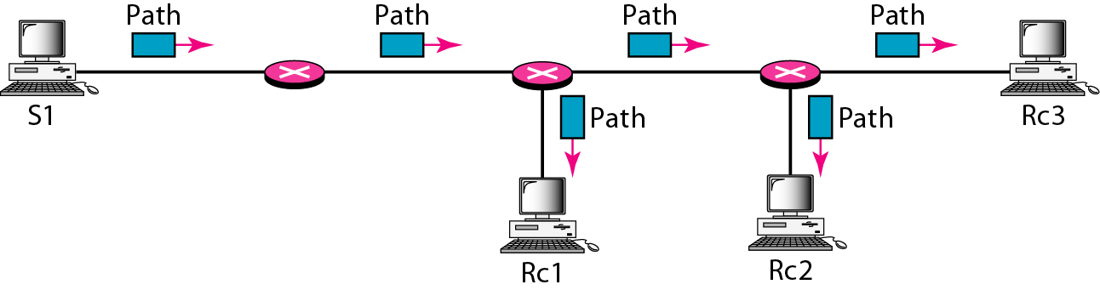
Path Messages
Path Messages Recall that the receivers in a flow make the reservation in RSVP. However, the receivers do not know the path traveled by packets before the reservation is made. The path is needed for the reservation. To solve the problem, RSVP uses Path messages. A Path message travels from the sender and reaches all receivers in the multicast path. On the way, a Path message stores the necessary information for the receivers. A Path message is sent in a multicast environment; a new message is created when the path diverges. Figure 22 shows path messages.
Figure 22 Path messages
Notes:
‹#›

Slide 33
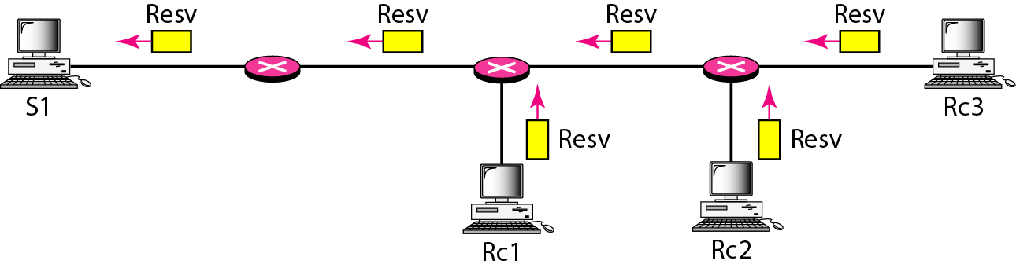
Resv Messages
Resv Messages After a receiver has received a Path message, it sends a Resv message. The Resv message travels toward the sender (upstream) and makes a resource reservation on the routers that support RSVP. If a router does not support RSVP on the path, it routes the packet based on the best-effort delivery methods we discussed before. Figure 23 shows the Resv messages.
Figure 23 Resv messages
Notes:
‹#›

Slide 34
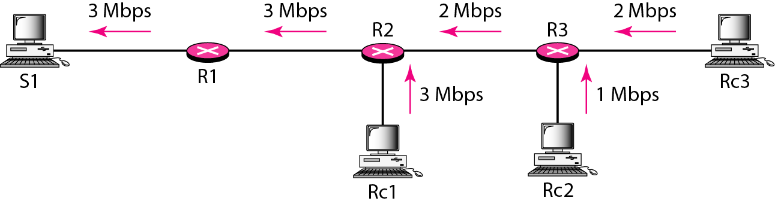
Reservation Merging
Figure 24 Reservation merging
Notes:
‹#›

Slide 35
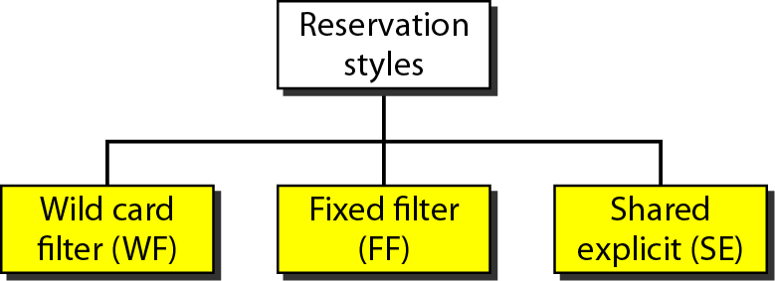
Reservation Styles
Figure 25 Reservation styles
Notes:
‹#›

Slide 36
Differentiated Services
Differentiated Services (DS or Diffserv) was introduced by the IETF (Internet Engineering Task Force) to handle the shortcomings of Integrated Services. Two fundamental changes were made:
The main processing was moved from the core of the network to the edge of the network. This solves the scalability problem. The routers do not have to store information about flows. The applications, or hosts, define the type of service they need each time they send a packet.
The per-flow service is changed to per-class service. The router routes the packet based on the class of service defined in the packet, not the flow. This solves the service-type limitation problem. We can define different types of classes based on the needs of applications.
Notes:
‹#›

Slide 37

DS field
The DS field contains two subfields: DSCP and CU. The DSCP (Differentiated Services Code Point) is a 6-bit subfield that defines the per-hop behavior (PHB). The 2-bit CU (currently unused) subfield is not currently used. The Diffserv capable node (router) uses the DSCP 6
Figure 26 DS field
Notes:
‹#›

Slide 38
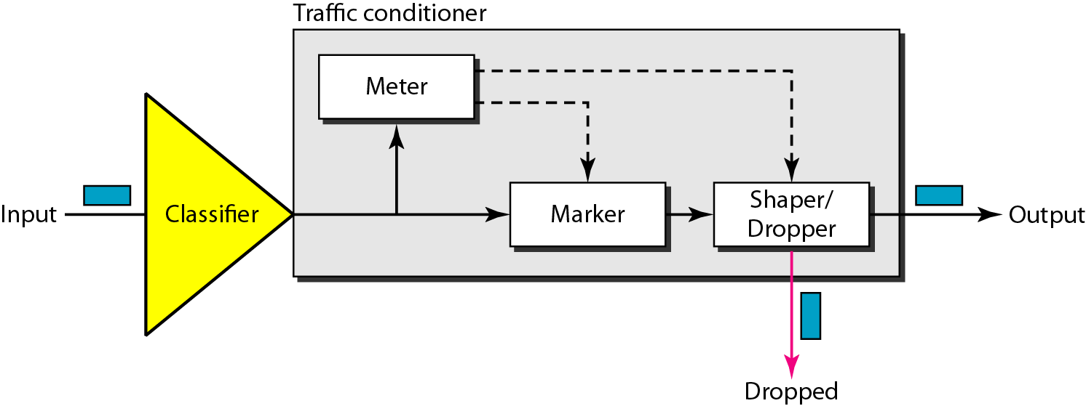
Traffic Conditioner
Figure 27 Traffic conditioner
Notes:
‹#›

Slide 39
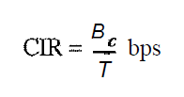
QoS IN SWITCHED NETWORKS
Let us now discuss QoS as used in two switched networks: Frame Relay and ATM. These two networks are virtual-circuit networks that need a signaling protocol such as RSVP.
QoS in Frame Relay
Four different attributes to control traffic have been devised in Frame Relay: access rate, committed burst size Be' committed information rate (CIR), and excess burst size Be‘ These are set during the negotiation between the user and the network. For PVC connections, they are negotiated once; for SVC connections, they are negotiated for each connection during connection setup. Figure 28 shows the relationships between these four measurements.
The cumulative number of bits sent during the predefined period cannot exceed Be
Note that the CIR is not an independent measurement; it can be calculated by using the following formula:
For example, if the Be is 5 kbits in a period of 5 s, the CIR is 5000/5, or 1 kbps.
Notes:
‹#›

Slide 40
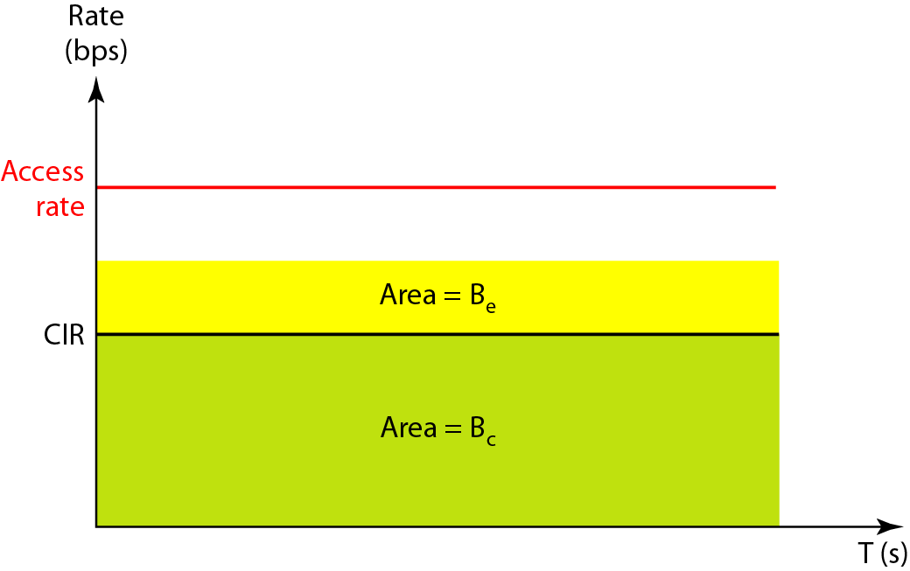
Relationship between traffic control attributes
Figure 28 Relationship between traffic control attributes
Notes:
‹#›

Slide 41
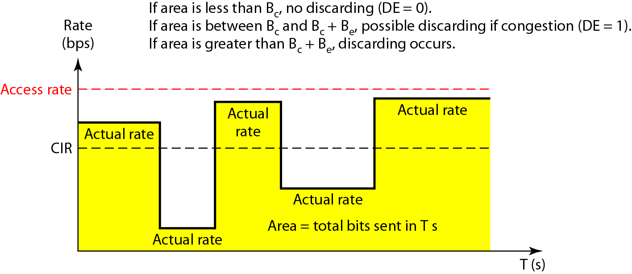
User rate in relation to Bc and Bc + Be
Figure 29 User rate in relation to Bc and Bc + Be
Notes:
‹#›

Slide 42
QoSinATM
The QoS in ATM is based on the class, user-related attributes, and network-related attributes.
Classes
The ATM Forum defines four service classes: CBR, VBR, ABR, and UBR (see Figure 30)
CBR The constant-bit-rate (CBR) class is designed for customers who need real-time audio or video services. The service is similar to that provided by a dedicated line such as a T line.
VBR The variable-bit-rate (VBR) class is divided into two subclasses: real-time (VBR-RT) and non-real-time (VBR-NRT). VBR-RT is designed for those users who need real-time services (such as voice and video transmission) and use compression techniques to create a variable bit rate. VBR-NRT is designed for those users who do not need real-time services but use compression techniques to create a variable bit rate.

Slide 43
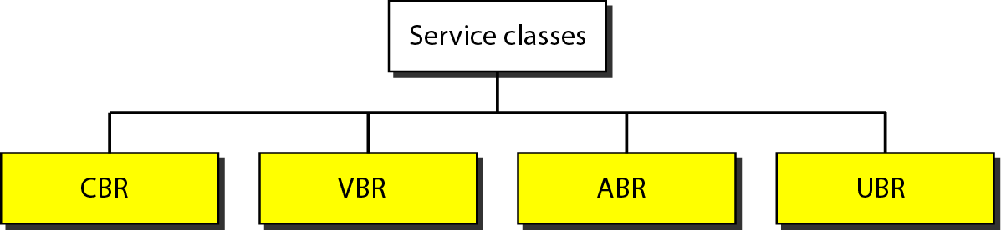
Service classes
ABR The available-bit-rate (ABR) class delivers cells at a minimum rate. If more network capacity is available, this minimum rate can be exceeded.
ABR is particularly suitable for applications that are bursty.
UBR The unspecified-bit-rate (UBR) class is a best-effort delivery service that does not guarantee anything.
Figure 30 Service classes
24.‹#›
Notes:
‹#›

Slide 44
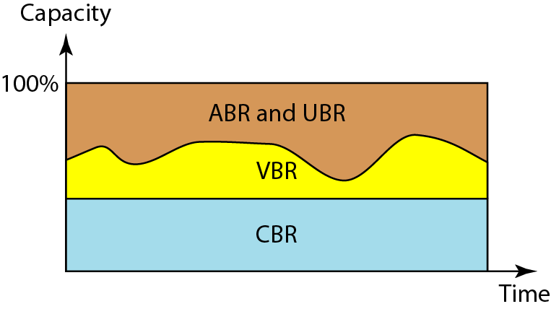
Relationship of service classes to the total capacity of the network
Figure 31 Relationship of service classes to the total capacity of the network
Notes:
‹#›

Slide 45
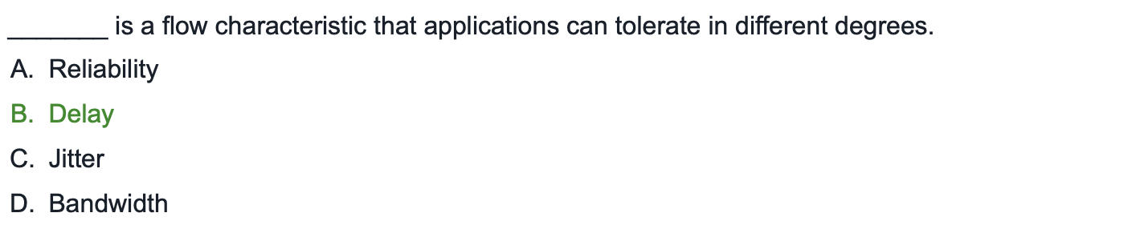
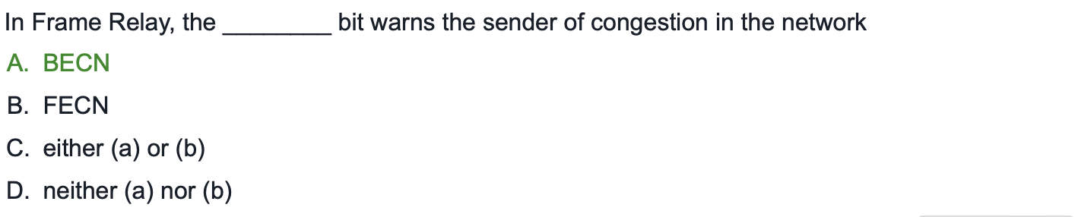
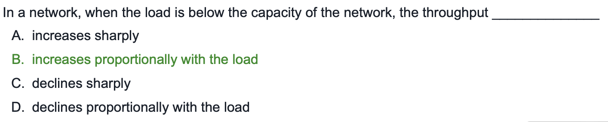
Practice Questions
24.‹#›

Slide 46
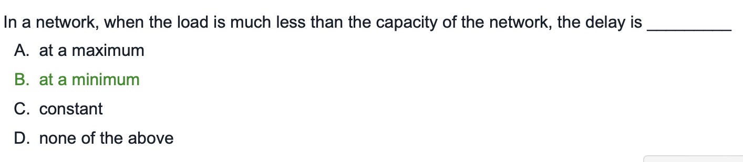
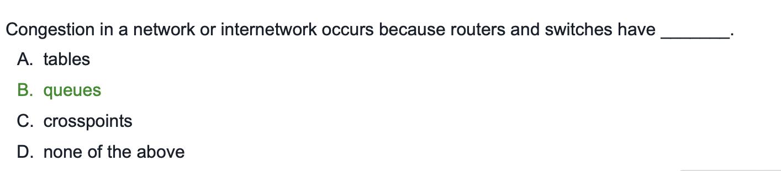
Practice Questions

Slide 47
Computer Networks

